Slide 1
OPTICS: Ordering Points To Identify the Clustering Structure
DBSCAN
  Input parameter – hard to determine.
  Algorithm very sensitive to input parameters.
OPTICS – Ankerst, Breunig, Kriegel, and Sander (SIGMOD’99)
  Based on DBSCAN.
  Does not produce clusters explicitly.
  Rather generate an ordering of data objects representing density-based clustering structure.

Slide 2
OPTICS con’t
Produces a special order of the database wrt its density-based clustering structure
This cluster-ordering contains info equiv to the density-based clusterings corresponding to a broad range of parameter settings
Good for both automatic and interactive cluster analysis, including finding intrinsic clustering structure
Can be represented graphically or using visualization techniques

Slide 3
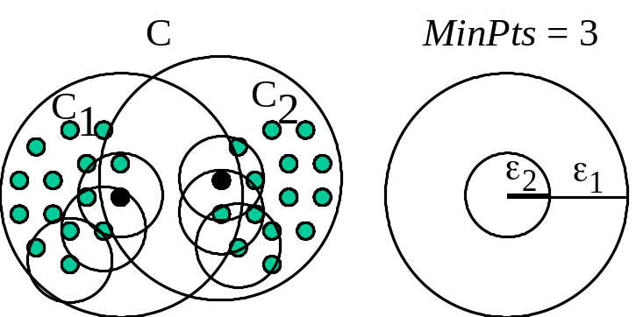
Density-Based Hierarchical Clustering
Observation: Dense clusters are completely contained
by less dense clusters
Idea: Process objects in the “right” order and keep track of point density in their neighborhood
C
D
C
1
C
2

Slide 4
Core- and Reachability Distance
Parameters: “generating” distance ε, fixed value MinPts
core-distance_{ε,MinPts}(o)
“smallest distance such that o is a core object”
(if that distance is ≤ ε ; “?” otherwise)
reachability-distance_{ε,MinPts}(p, o)
“smallest distance such that p is
directly density-reachable from o”
(if that distance is ≤ ε ; “?” otherwise)
MinPts = 5
p
o
ε
q
core-distance(o)
reachability-distance(p,o)
reachability-distance(q,o)

Slide 5
OPTICS: Extension of DBSCAN
Order points by shortest reachability distance to guarantee that clusters w.r.t. higher density are finished first. (for a constant MinPts, higher
density requires lower ε)

Slide 6

The Algorithm OPTICS
Basic data structure: controlList
  Memorize shortest reachability distances seen so far
  (“distance of a jump to that point”)
Visit each point
  Make always a shortest jump
Output:
  order of points
  core-distance of points
  reachability-distance of points

Slide 7
The Algorithm OPTICS
ControlList ordered by reachability-distance.
ControlList
cluster-ordered
file
≥
foreach o ∈ Database
// initially, o.processed = false for all objects o
if o.processed = false;
insert (o, “?”) into ControlList;
while ControlList is not empty
select first element (o, r-dist) from ControlList;
retrieve N_{ε}(o) and determine c_dist= core-distance(o);
set o.processed = true;
write (o, r_dist, c_dist) to file;
if o is a core object at any distance ≤ ε
foreach p ∈ N_{ε}(o) not yet processed;
determine r_dist_{p} = reachability-distance(p, o);
if (p, _) ∉ ControlList
insert (p, r_dist_{p}) in ControlList;
else if (p, old_r_dist) ∈ ControlList and r_dist_{p} < old_r_dist
update (p, r_dist_{p}) in ControlList;
database

Slide 8
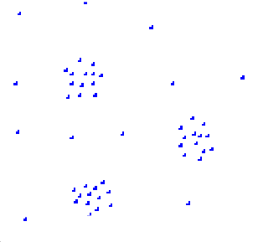
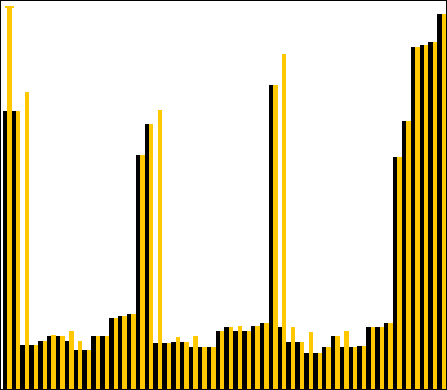
OPTICS: Properties
“Flat” density-based clusters wrt. ε* ≤ ε and MinPts afterwards:
  Starts with an object o where c-dist(o) ≤ ε* and r-dist(o) > ε*
  Continues while r-dist ≤ ε*
Performance: approx. runtime( DBSCAN(ε, MinPts) )
  O( n * runtime(ε-neighborhood-query) )
    without spatial index support (worst case): O( n² )
    e.g. tree-based spatial index support: O( n ∗ log(n) )
1
2
17
3
16
18
3
1
4
4
2
16
17
18
Core-distance
Reachability-distance

Slide 9
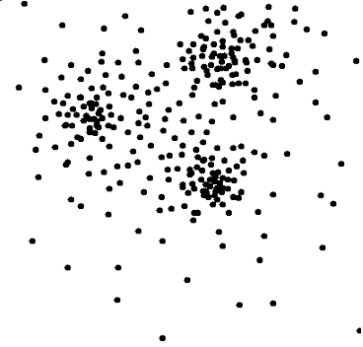
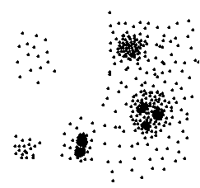

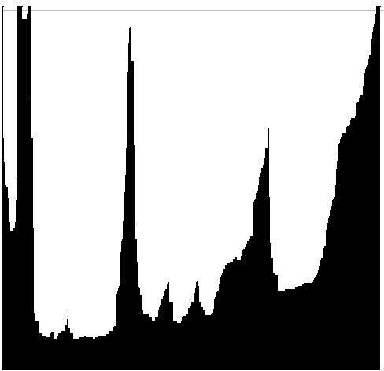
OPTICS: The Reachability Plot
represents the density-based clustering structure
easy to analyze
independent of the dimension of the data
reachability distance
reachability distance
cluster ordering
cluster ordering

Slide 10

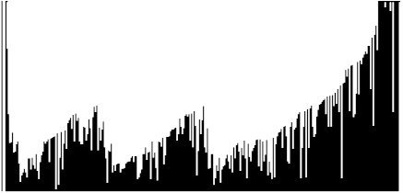
OPTICS: Parameter Sensitivity
Relatively insensitive to parameter settings
Good result if parameters are just
“large enough”
1
3
2
MinPts = 10, ε = 10
MinPts = 10, ε = 5
MinPts = 2, ε = 10
1
2
3
1
2
3
1
2
3

Slide 11


An Example of OPTICS
neighboring objects stay close to each other in a linear
sequence.
Reachability-distance
undefined
‘
Cluster-order of the objects

Slide 12
DBSCAN VS OPTICS
 | DBSCAN | OPTICS
Density | Boolean value (high/low) | Numerical value (core distance)
Density-connected | Boolean value (yes/no) | Numerical value (reachability distance)
Searching strategy | random | greedy

Slide 13

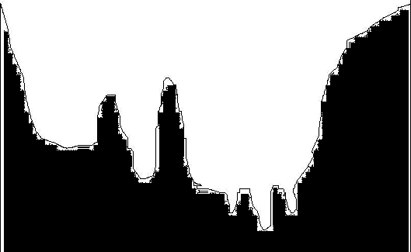
When OPTICS Works Well
Cluster-order of the objects

Slide 14
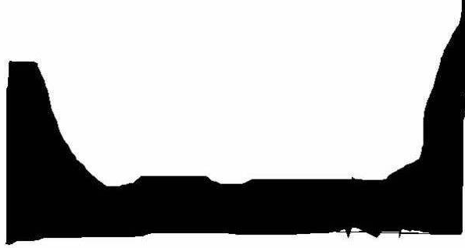
When OPTICS Does NOT Work Well
Cluster-order of the objects

